Slide 1
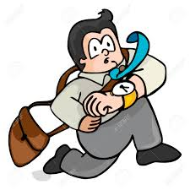
The man goes late to his job.

Slide 2
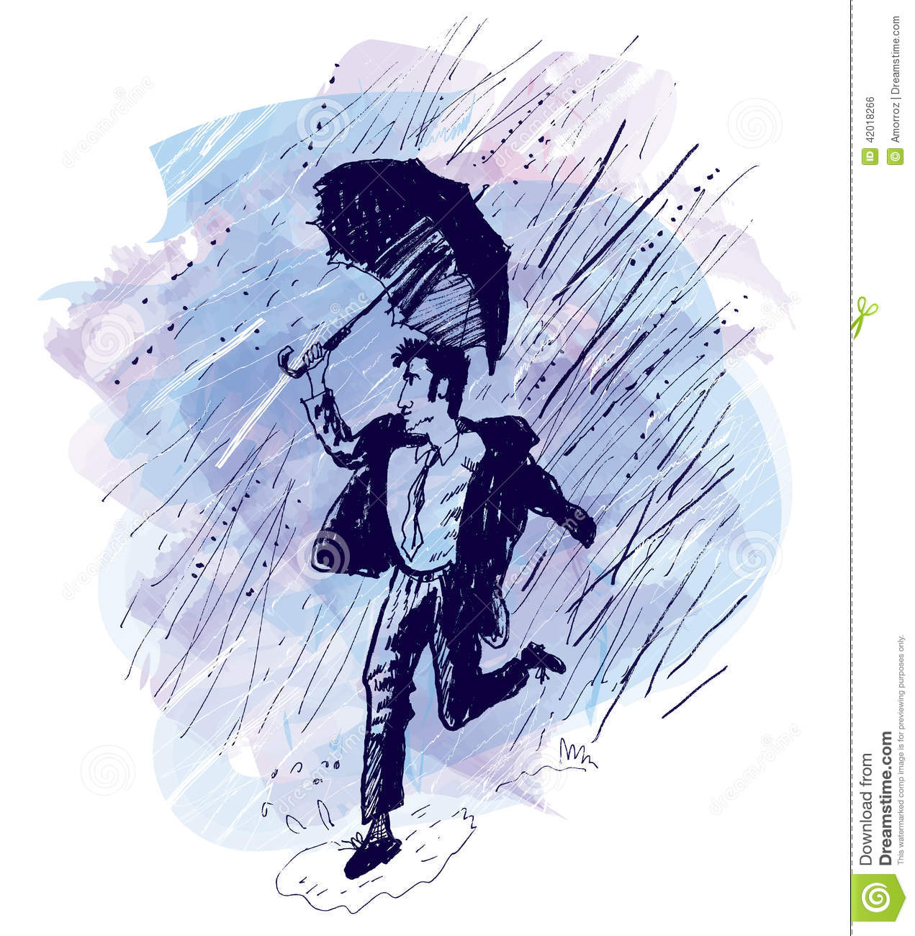
Start to rain, strange dance.

Slide 3
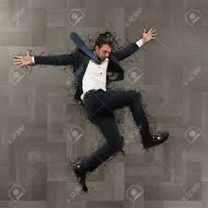
The man fell on the floor.

